Slide 1

How can real digital money look like?
David Antoš
9. Října 2021

Slide 2
Crypto & I: A skeptical Ethereum maximalist
Tyler Cowen: "Will fall to near-zero in value. Hold it at your own risk. The original issuers will have kept some of their initial gains. The new Bitcoin asset simply isn’t a useful one."
Friend/colleague: "Bitcoin is a really cool technology, put in one month of salary and you'll seen one day."
(Would be worth $2M today.)
Balaji Srinivasan: "Internet lacks a transaction protocol, programmable money could disrupt platforms like AWS."
I buy my first ETH, price falls 80% eventually.
I upgrade my iPhone, lose my keys and all ETH.
Buying in again during the covid spring bottom. Majority of my savings now.
BTC
$1,200
ETH
$3,000
$46
$200
2010
2012
2014
2016
2018
2020
2022

Slide 3
Nevertheless, bitcoin & ether are still not money. And definitely not sound or ultrasound.

Slide 4
By definition, money serve three purposes
Medium of exchanges
Widely accepted
Highly liquid
Stable esp. in the very short horizon (the duration of a single transaction)
Better inflationary than deflationary
Accounting unit
Stable in short and medium term – no need to frequently update
Intuitively known, understood and accepted
Store of value
Resistant to short-term fluctuations
Long-term preserving value as a % of GDP (=deflationary)

Slide 5
Neither bitcoin nor ether are money because they cannot be accounting units
Dolar
Bitcoin
Ether
Medium of exchange
Accounting unit
Medium of exchange
Accounting unit
Medium of exchange
Accounting unit
But: NFTs are often denominated and stable in ETH, not USD
Store of value
Store of value
Store of value
Universally accepted and liquid globally
Intuitivelly understood value, highly stable vs. CPI (consumer basket)
Minimal short-term fluctuation
Long-term steady (and predictable) loss of value due to inflation
Quite liquid, rising acceptance
Extremely volatile in all time horizons
Value based on a (Ponzi) meme, during crisis declined just as other assets
Quite liquid, rising acceptance
Extremely volatile in all time horizons
Value based on future rent from operating the Ethereum blockchain DB (but realistic?), can be roughly stable as a % of GDP

Slide 6
Money cannot be a store of long-term value. Money needs a controlled expansion & contraction for stable price levels.

Slide 7
BTC (just as ETH) is not good for setting prices due to extreme instability – even gold was bad money
Value of $100 in 2011 adjusted for inflation and commodity price changes
Instability and unpredictable changes hurt the economy
Commodities are affected by random events shifting value up and down (see gold) in line with market sentiment, supply volume etc.
Deflation deters people from spending money – they rather save them. Good money is primarily for transactions, not hoarding
Price changes are costly if not automated ("menu costs")
Price of goods can go down, but wages are sticky, deflation distorts the labor market
Hence, central banks replaced random inflation and deflation with a 2% inflation strategy
102.07
103.56
105.24
105.36
USD
90.38
100.00
Gold
3.44
BTC
2012
2013
2014
2015
2016
2017
2018
2019
2020

Slide 8
However, web 3.0/DeFi needs tokenized money – and perhaps it can even innovate better money
Money is better medium of exchange than collectible coins like BTC or "stocks" like ETH even in the digital world – we need money that works directly on blockchain
On to of that, not all countries have well-functioning central banks that protect stable money – and a non-state "unstoppable" alternative can be better than "dollarization"
Even quality central banks pose a risk – we need to trust their leadership that the arbitrary "money printing" decision will continue to be good long-term and forever
Competition of state and non-state money can open the doors to experimentation and innovations; in principle, should be as beneficial as in other industries
At the same time, the world is not an Optimal Monetary Zone – even the digital world we probably need multiple "local" currencies – digital euro? digital crown?

Slide 9
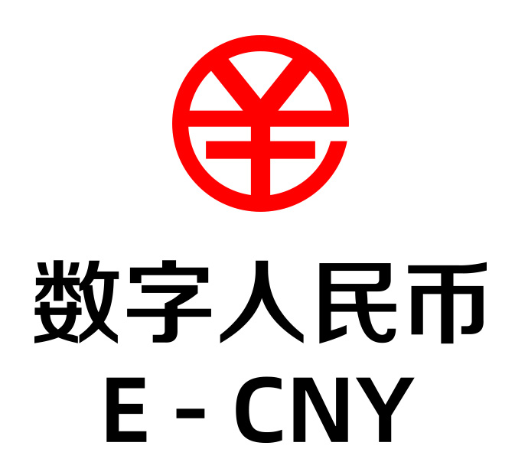



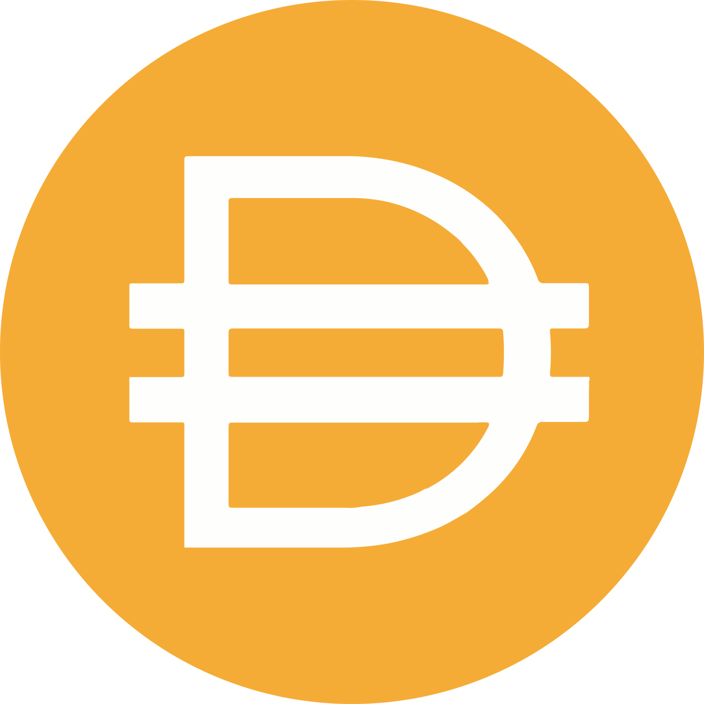




There are five types of candidates for digital money
CBDC
Centralized
Pegged to fiat & (over)collateralized
Pegged to fiat & un(der)collateralized
Unpegged to fiat
Pegged to CPI?
From the central bank directly without intermediaries
BUT: Central banks hesitate so far; they do not want to launch on open blockchains. CBDC will likely be more controlled than paper money (for quite good reasons)
Synthetic stablecoins printed by a private entity
The dominant for of crypto money today, "second best" approach
BUT: Uncleat backing of tokens with assets, ultimately controllable by officials, not independent from fiat money
Synthetic stablecoins printed against a collateral locked in smart contracts
BUT: Over 50 % of DAI collateral is USDC (with all the risks), overcollateralization is wasteful, peg is enforced through governance voting, extra smart contract risks, not independent from fiat money
Synthetic stablecoins printed against undercollateralization
BUT: Much higher risks, possibility of a "bank run" and value collapse
Simulate how central banks operate through (algorithmic) monetary policy to preserve stable (but moving) value
BUT: Can be only reactive (CBs predict and act proactively through sophisticated modelling); not validated that RAI wouldn't just follow dollar inflation

Slide 10
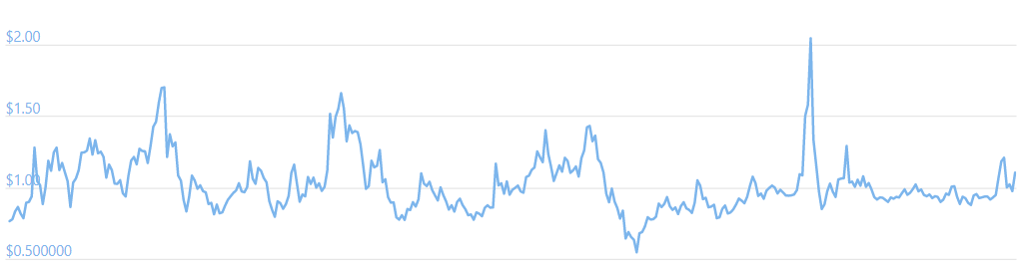
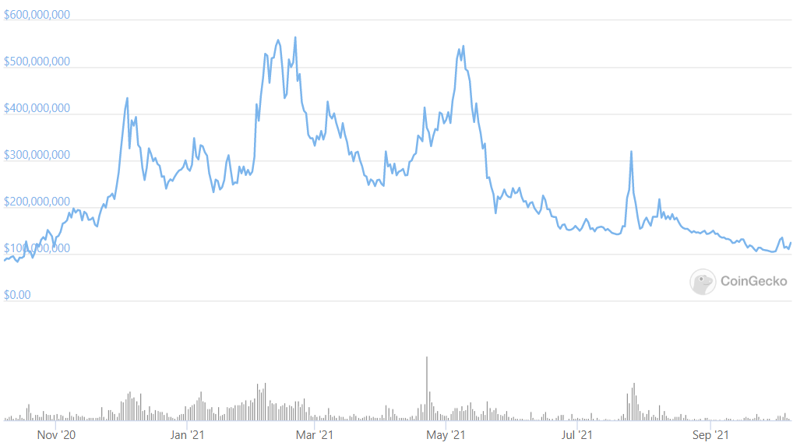
AMPL: Stable price but not value
Every 24 hours, Ampleforth adjusts the total number of tokens according to their current price to reach $1 (in 2019 value)
Value in the wallet stays the same as price changes by same amount as number of tokens for each user
Through this trick, AMPL preserve same nominal value; number of tokens owned fluctuates instead
Does not require any collateral –AMPL value collapse would simply lower number of tokens all the way to zero
It's an entertaining mechanism but delivers no practical advantage (inflation and deflation still happens just expressed differently)
AMPL/USD
Market Cap

Slide 11
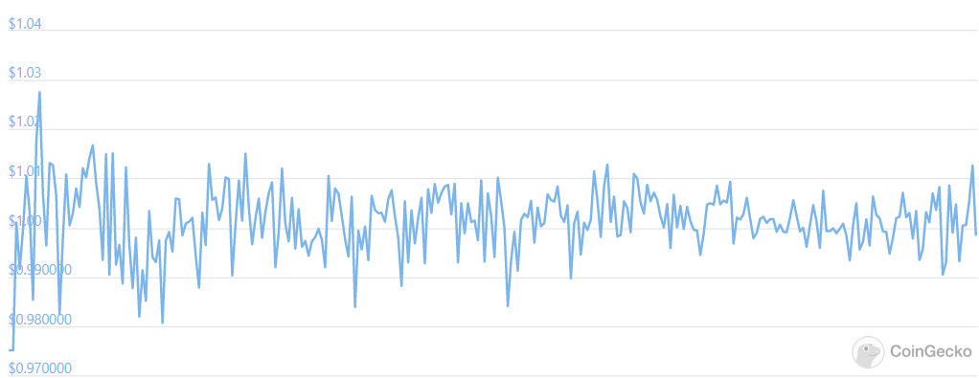
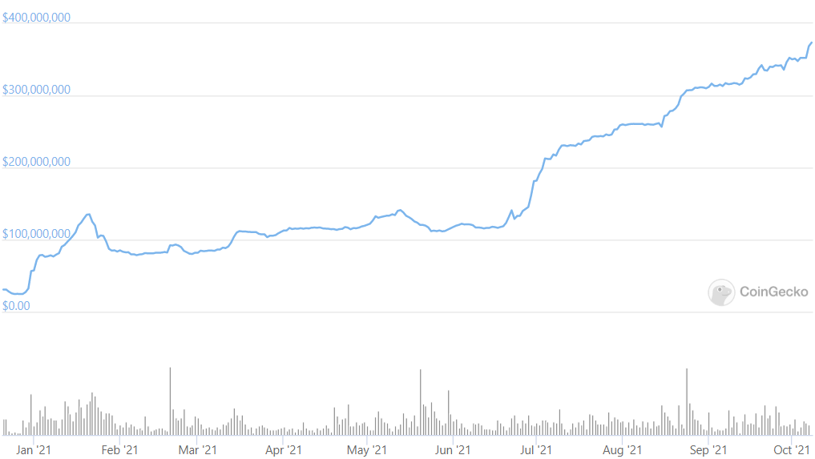
FRAX: Undercollateralized money
FRAX/USD
Frax is 60% backed by a stablecoin collateral (USDC), rest is printed and paid back in governance token FXS
USDC generates extra income from Aave etc.
If the value of FRAX rises over $1, FXS and USDC holder can print a new coin and sell with profit
If the value of FRAX falls below $1, any holder can exchange it for an equivalent in USDC and FXS and sell with profit
The dual tokens are accompanied by FXB "bond" for adding liquidity in the case of a large drop
Frax is a classical algorithmic stablecoin with a bit lower risk of collapse (60c USDC is always left)
Market Cap

Slide 12
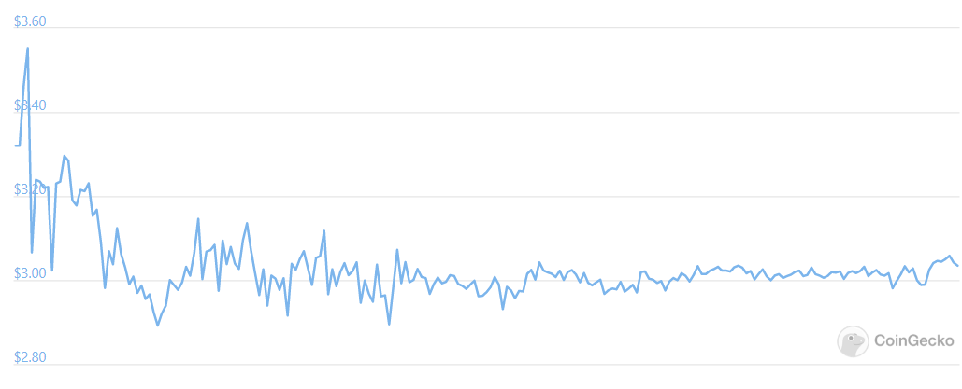
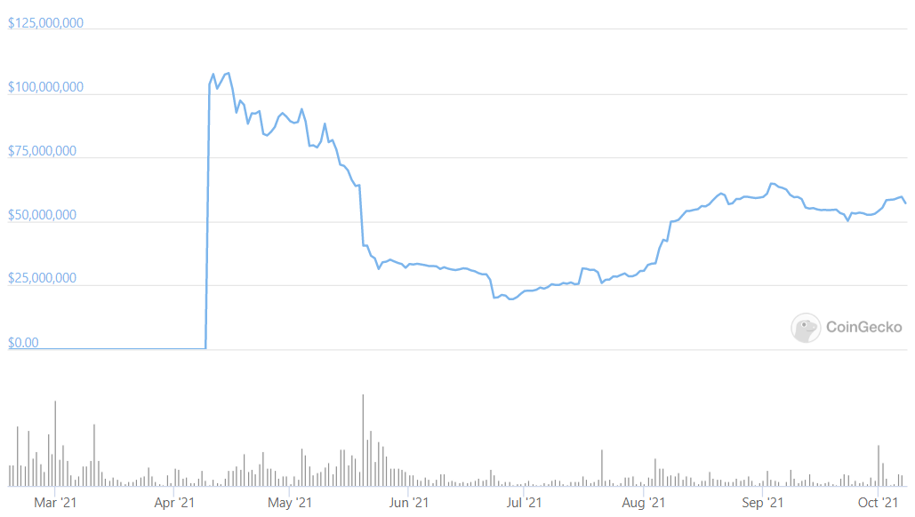
RAI: Unpegged money – yet stable
RAI/USD
Reflexer / RAI functions very similar to Maker / DAI: RAI is printed against a collateral (exclusively ETH) for "target price"
If market prices rises above the "target price", "target price" starts to get steadily decline
If market prices declines below the "target price", "target price" starts to get steadily increase
Both motivates to return to stability (the larger the gap the higher the arbitrage opportunity)
Open question: Will RAI track USD or would it be less sensitive to the underlying fiat inflation as it is not pegged directly?
Market Cap

